Slide 1
NodeJS & opeNode
Deploy NodeJS App to opeNode

Slide 2
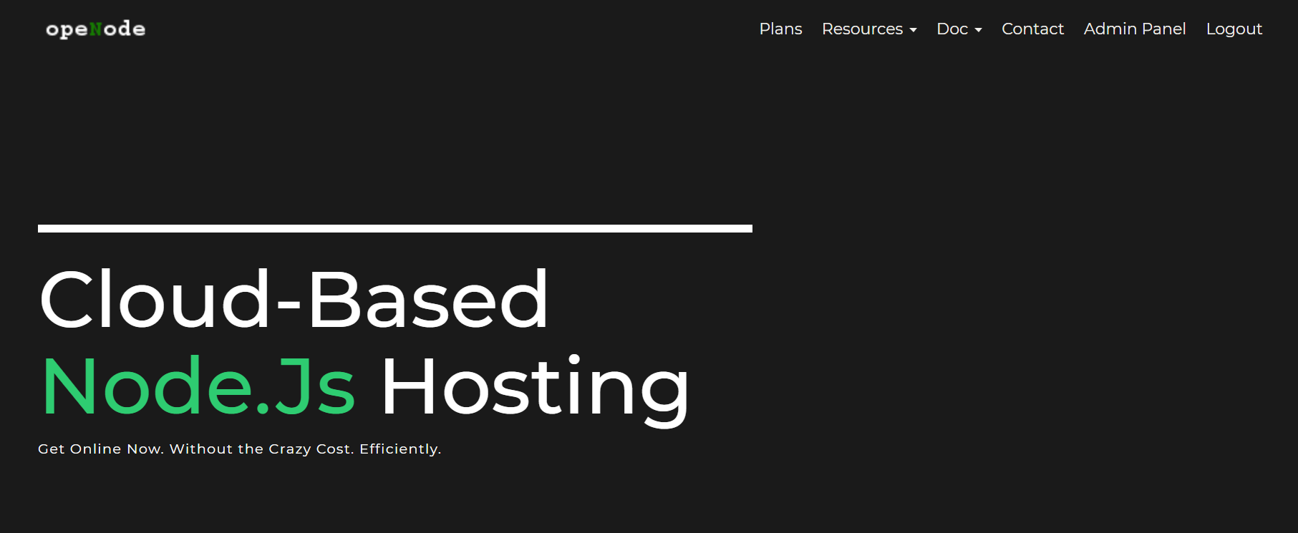
opeNode (https://www.openode.io/) is a reliable and fast Cloud Node.js hosting service to deploy your Node.js app instantly. First create an account here!

Slide 3
#1 opeNode CLI
opeNode Command Line Interface is built with Node.js and is installable via npm.
Login on opeNode then install opeNode CLI globally:
$ npm install -g openode

Slide 4
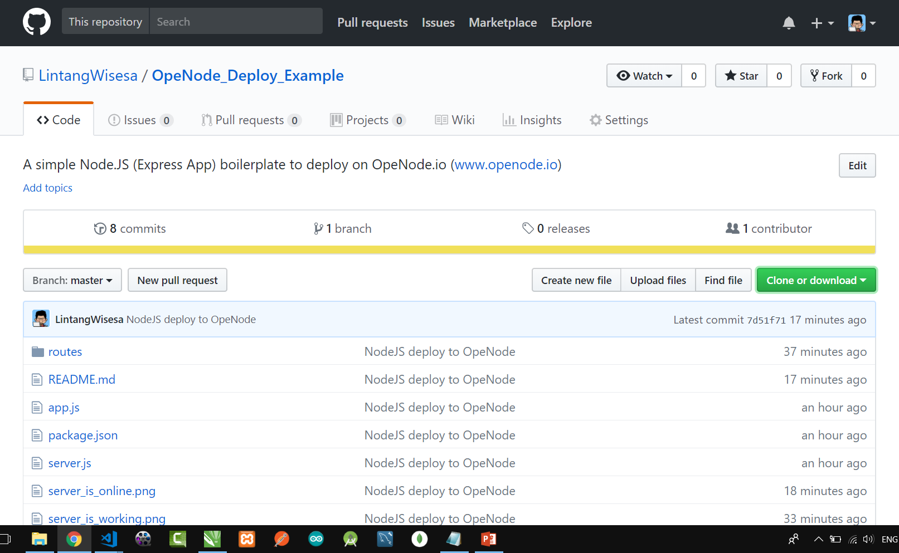
#2 Clone NodeJS Boilerplate
Clone NodeJS boilerplate that can be deployed to opeNode from my repo:
$ git clone https://github.com/LintangWisesa/OpeNode_Deploy_Example.git

Slide 5
#3 Edit App
Go to the repo, then install all packages needed:
$ cd OpeNode_Deploy_Example
$ npm install
Edit Express app route on routes/renderer.js! Make sure there is no error on your app by running server.js. Server will be running by default on localhost:3002!
$ node server
or simply by using this command:
$ npm start
Open localhost:3002 via browser, then try also to open localhost:3002/something!

Slide 6
#4 Deploy App to OpeNode
So your app is working fine locally. Now, it's time to deploy to opeNode:
$ openode deploy
Answer some questions & follow its process till done.
Would you like to [l]ogin or [r]egister a new account?: (r) l
email: lintang@wisesa.com
password: *****
[DDD MMM dd yyyy hh:mm:ss GMT+0700 (SE Asia Time)] [+] Authentication valid.
Type your subdomain sitename (Example: my-site) OR custom domain (mysite.com): lintang
On last step, we will get our app's URL on opeNode:
[ { location: 'france', result: {
result: 'success', URL: 'http://my_url.fr.openode.io/' } } ]

Slide 7
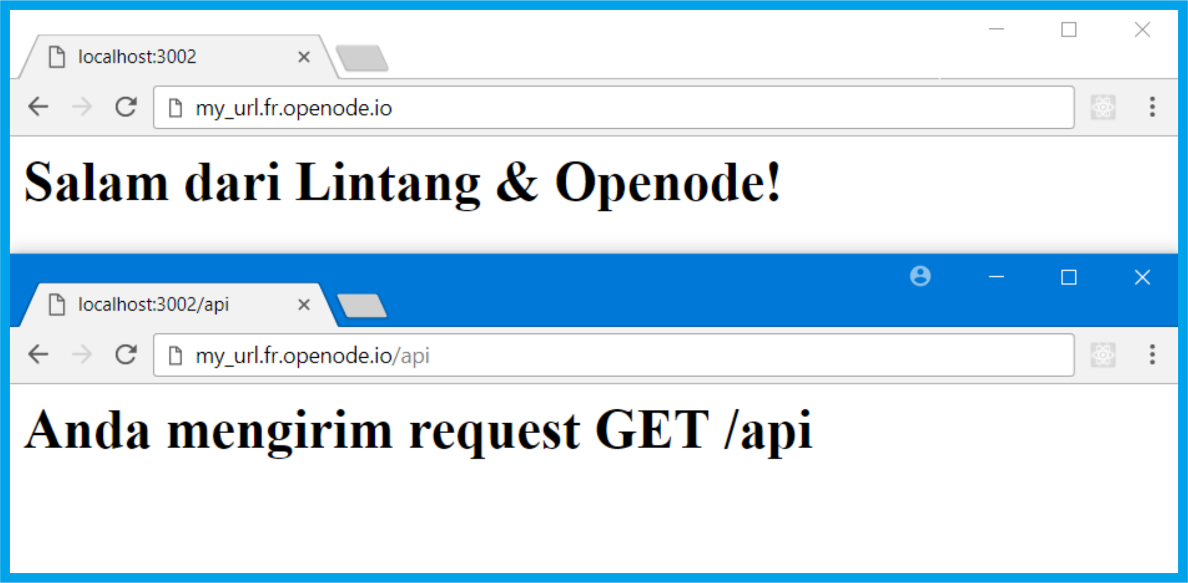
Your Project Has Been Deployed!

Slide 8
NodeJS & opeNode
Deploy NodeJS App to opeNode

